Slide 1
Associate Analytics Program – Day 6 & 7
Continuous Distributions
Learning Objectives
Understand concepts of the continuous distribution, especially the normal distribution.
Recognize normal distribution problems, and know how to solve them.
Decide when to use the normal distribution to approximate binomial distribution problems, and know how to work them.
Decide when to use the exponential distribution to solve problems in business, and know how to work them.

Slide 2
Continuous Distribution
Continuous Distributions :
Continuous distributions are constructed from continuous random variables which can be any values over a given interval
With continuous distributions, probabilities of outcomes occurring between particular points are determined by calculating the area under the curve between these points
Unlike discrete probability distributions, the probability of being exactly at a given point is 0 (since you can measure it more precisely)

Slide 3
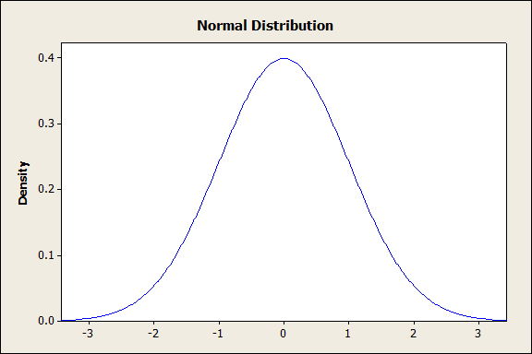
Continuous Distribution
Properties of Normal Distributions :
Characteristics of the normal distribution:
Continuous distribution - Line does not break
Bell-shaped, symmetrical distribution
Ranges from -∞ to ∞
Mean = median = mode
Area under the curve = total probability = 1
68% of data are within one std dev of mean, 95% within two std devs, and 99.7% within three std devs

Slide 4
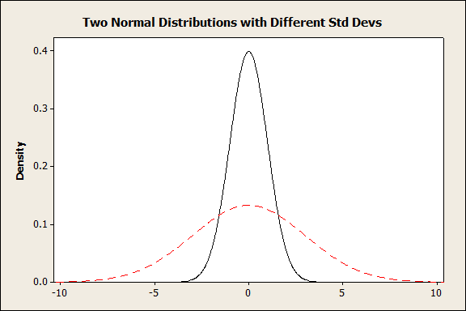
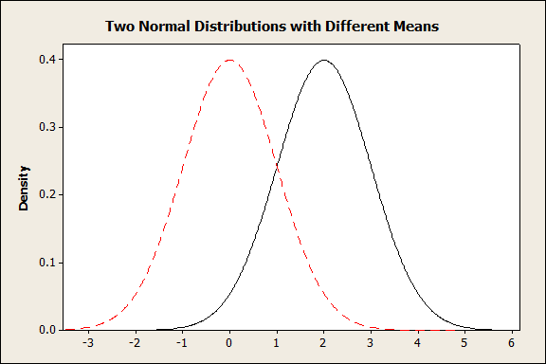
Continuous Distribution
Probability density function of Normal Distributions :
There are a number of different normal distributions, they are characterized by the mean and the standard deviation.

Slide 5
Continuous Distribution
Probability density function of Normal Distributions :
X

Slide 6
Continuous Distribution
Normal Distributions : Calculating Probabilities :
Rather than create a different table for every normal distribution (with different mean and std devs), we can calculate a standardized normal distribution, called Z
A z-score gives the number of standard deviations that a value x is above the mean.
Z distribution is normal distribution with a mean of 0 and a std dev of 1

Slide 7
Continuous Distribution
Standardised Normal Distributions :
Z distribution probability values are given in table or can be calculated using software
Table gives the total area under the Z curve between 0 and any point on the positive Z axis
Since the curve is symmetric, the area under the curve between Z and 0 is the same whether the Z curve is positive or negative

Slide 8
Continuous Distribution
Z Table :
.
Second Decimal Place in Z
Z 0.00 0.01 0.02 0.03 0.04 0.05 0.06 0.07 0.08 0.09
0.00 0.0000 0.0040 0.0080 0.0120 0.0160 0.0199 0.0239 0.0279 0.0319 0.0359
0.10 0.0398 0.0438 0.0478 0.0517 0.0557 0.0596 0.0636 0.0675 0.0714 0.0753
0.20 0.0793 0.0832 0.0871 0.0910 0.0948 0.0987 0.1026 0.1064 0.1103 0.1141
0.30 0.1179 0.1217 0.1255 0.1293 0.1331 0.1368 0.1406 0.1443 0.1480 0.1517
0.90 0.3159 0.3186 0.3212 0.3238 0.3264 0.3289 0.3315 0.3340 0.3365 0.3389
1.00 0.3413 0.3438 0.3461 0.3485 0.3508 0.3531 0.3554 0.3577 0.3599 0.3621
1.10 0.3643 0.3665 0.3686 0.3708 0.3729 0.3749 0.3770 0.3790 0.3810 0.3830
1.20 0.3849 0.3869 0.3888 0.3907 0.3925 0.3944 0.3962 0.3980 0.3997 0.4015
2.00 0.4772 0.4778 0.4783 0.4788 0.4793 0.4798 0.4803 0.4808 0.4812 0.4817
3.00 0.4987 0.4987 0.4987 0.4988 0.4988 0.4989 0.4989 0.4989 0.4990 0.4990
3.40 0.4997 0.4997 0.4997 0.4997 0.4997 0.4997 0.4997 0.4997 0.4997 0.4998
3.50 0.4998 0.4998 0.4998 0.4998 0.4998 0.4998 0.4998 0.4998 0.4998 0.4998

Slide 9
Continuous Distribution
Table lookup for standard normal probability:
.
Z 0.00 0.01 0.02
0.00 0.0000 0.0040 0.0080
0.10 0.0398 0.0438 0.0478
0.20 0.0793 0.0832 0.0871
1.00 0.3413 0.3438 0.3461
1.10 0.3643 0.3665 0.3686
1.20 0.3849 0.3869 0.3888
-3
-2
-1
0
1
2
3

Slide 10
Continuous Distribution
Applying Z formula :
.
Z 0.00 0.01 0.02
0.00 0.0000 0.0040 0.0080
0.10 0.0398 0.0438 0.0478
1.00 0.3413 0.3438 0.3461
1.10 0.3643 0.3665 0.3686
1.20 0.3849 0.3869 0.3888

Slide 11
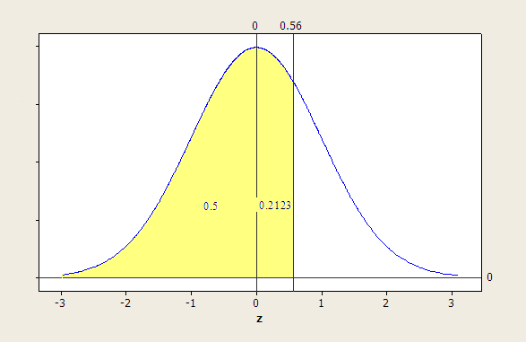
Continuous Distribution
Applying Z formula :
.
0.5 + 0.2123 = 0.7123

Slide 12
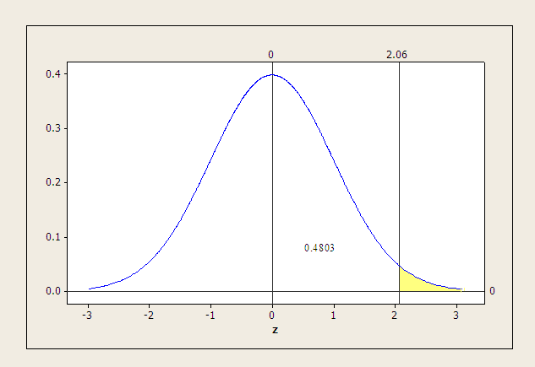
Continuous Distribution
Applying Z formula :
.
0.5 – 0.4803 = 0.0197

Slide 13
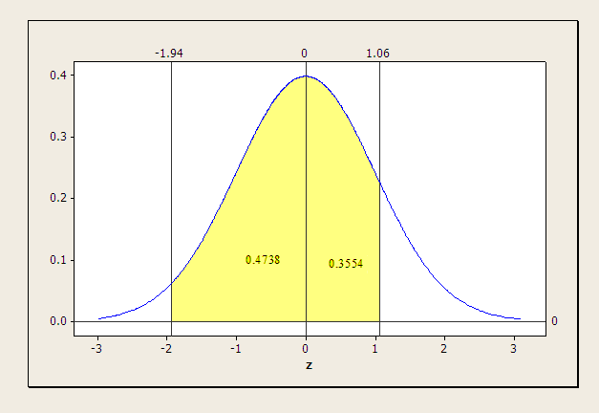
Continuous Distribution
Applying Z formula :
.
0.4738+ 0.3554 = 0.8292

Slide 14
Continuous Distribution
Normal Approximation of Binomial Distribution :
For certain types of binomial distributions, the normal distribution can be used to approximate the probabilities
- At large sample sizes, binomial distributions approach the normal distribution in shape regardless of the value of p
- The normal distribution is a good approximate for binomial distribution problems for large values of n

Slide 15
Continuous Distribution
Normal Approximation of Binomial Distribution : Parameter Conversion :
Conversion equations
Conversion example:
.

Slide 16
Continuous Distribution
Normal Approximation of Binomial Distribution : Interval Check :
0
10
20
30
40
50
60
n
70

Slide 17
Continuous Distribution
Normal Approximation of Binomial Distribution : Correcting for Continuity :
Values Being Determined
Correction
X>
X≥
X<
X≤
≤X≤
<X<
+.50
-.50
-.50
+.05
-.50 and +.50
+.50 and -.50

Slide 18
Continuous Distribution
Normal Approximation of Binomial Distribution : Binomial Computations :
X
P(X)
25
26
27
28
29
30
31
32
33
Total
0.0167
0.0096
0.0052
0.0026
0.0012
0.0005
0.0002
0.0001
0.0000
0.0361

Slide 19
Continuous Distribution
Exponential Distribution :
Another common continuous distribution is the exponential distribution
Example – the time until a light bulb works is known to follow an exponential distribution
It’s skewed to the right
Apex is always at X = 0
Steadily decreases as X gets larger

Slide 20
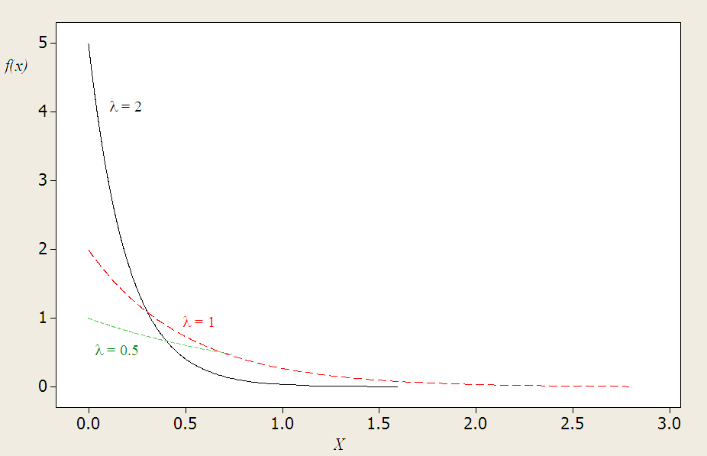
Continuous Distribution
Different Exponential Distributions :

Slide 21
Continuous Distribution
Exponential Distributions Probability Computations :
1.2
1.0
λ = 1.2
0.8
0.6
0.4
0.2
0.0
0
1
2
3
4
5

Slide 22
Associate Analytics Program – Day 8
Sampling & Control Limit Theorem
Learning Objectives
Determine when to use sampling.
Determine the pros and cons of various sampling techniques.
Be aware of the different types of errors that can occur in a study.
Understand the impact of the Central Limit Theorem on statistical analysis.
Use the sampling distributions of the sample mean and sample proportion.

Slide 23
Sampling & CLT
Reasons for Sampling :
Sampling – A means for gathering information about a population without conducting a census
Information gathered from sample, and inference is made about the population
Sampling has advantages over a census
Sampling can save money.
Sampling can save time.

Slide 24
Sampling & CLT
Random vs Nonrandom Sampling :
Nonrandom Sampling - Every unit of the population does not have the same probability of being included in the sample
Random sampling - Every unit of the population has the same probability of being included in the sample.

Slide 25
Sampling & CLT
Random Sampling Techniques:
Simple Random Sample – basis for other random sampling techniques
Each unit is numbered from 1 to N (the size of the population)
A random number generator can be used to select n items that form the sample

Slide 26
Sampling & CLT
Random Sampling Techniques:
Stratified Random Sample
The population is broken down into strata with like characteristics (i.e. men and women OR old, young, and middle-aged people)
Efficient when differences between strata exist
Proportionate (% of the sample from each stratum equals % that each stratum is within the whole population)
Systematic Random Sample
Define k = N/n. Choose one random unit from first k units, and then select every k^{th} unit from there.
Cluster (or Area) Sampling
The population is in pre-determined clusters (students in classes, apples on trees, etc.)
A random sample of clusters is chosen and all or some units within the cluster is used as the sample

Slide 27
Sampling & CLT
Simple Random Sample : Population members : Random Sample using excel
01 Alaska Airlines
02 Alcoa
03 Ashland
04 Bank of America
05 BellSouth
06 Chevron
07 Citigroup
08 Clorox
09 Delta Air Lines
10 Disney
11 DuPont
12 Exxon Mobil
13 General Dynamics
14 General Electric
15 General Mills
16 Halliburton
17 IBM
18 Kellog
19 KMart
20 Lowe’s
21 Lucent
22 Mattel
23 Mead
24 Microsoft
25 Occidental Petroleum
26 JCPenney
27 Procter & Gamble
28 Ryder
29 Sears
30 Time Warner
Population size of N = 30
Desired sample size of n = 6

Slide 28
Sampling & CLT
Simple Random Sample : Sample members :
01 Alaska Airlines
02 Alcoa
03 Ashland
04 Bank of America
05 BellSouth
06 Chevron
07 Citigroup
08 Clorox
09 Delta Air Lines
10 Disney
11 DuPont
12 Exxon Mobil
13 General Dynamics
14 General Electric
15 General Mills
16 Halliburton
17 IBM
18 Kellog
19 KMart
20 Lowe’s
21 Lucent
22 Mattel
23 Mead
24 Microsoft
25 Occidental Petroleum
26 JCPenney
27 Procter & Gamble
28 Ryder
29 Sears
30 Time Warner

Slide 29
Sampling & CLT
Systematic Sampling : Example :
Purchase orders for the previous fiscal year are serialized 1 to 10,000 (N = 10,000).
A sample of fifty (n = 50) purchases orders is needed for an audit.
k = 10,000/50 = 200

Slide 30
Sampling & CLT
Systematic Sampling : Example :
First sample element randomly selected from the first 200 purchase orders. Assume the 45th purchase order was selected.
Subsequent sample elements: 45, 245, 445, 645, . . .

Slide 31
Sampling & CLT
Convinience ( Non – Random ) Sampling :
Non-Random sampling – sampling techniques used to select elements from the population by any mechanism that does not involve a random selection process
These techniques are not desirable for making statistical inferences
Example – choosing members of this class as an accurate representation of all students at our university, selecting the first five people that walk into a store and ask them about their shopping preferences, etc.

Slide 32
Sampling & CLT
Non Sampling Errors :
Non-sampling Errors – all errors that exist other than the variation expected due to random sampling
Missing data, data entry, and analysis errors
Leading questions, poorly conceived concepts, unclear definitions, and defective questionnaires
Response errors occur when people do not know, will not say, or overstate in their answers

Slide 33
Sampling & CLT
Sampling Distribution of mean Xbar :
Proper analysis and interpretation of a sample statistic requires knowledge of its distribution.
Process of
Inferential Statistics

Slide 34
Sampling & CLT
Central Limit Theorem :
Consider taking a sample of size n from a population
The sampling distribution of the sample mean is the distribution of the means of repeated samples of size n from a population
The central limit theorem states that as the sample size increases,
The shape of the distribution becomes a normal distribution (this condition is typically consider to be met when n is at least 30)
The variance decreases by a factor of n

Slide 35
Sampling & CLT
Sampling for Normal Population :
The distribution of sample means is normal for any sample size.

Slide 36
Sampling & CLT
Z Formula for Sample Means

Slide 37
Sampling & CLT
Example :
Suppose that the mean expenditure per customer at a tire store is $85.00, with a standard deviation of $9.00. If a random sample of 40 customers is taken, what is the probability that the sample average expenditure per customer for this sample will be $87.00 or more?
Solution: Because the sample size is greater than 30, the central limit theorem can be used to state that the sample mean is normally distributed and the problem can proceed using the normal distribution calculations.

Slide 38
Sampling & CLT
Example :

Slide 39
Sampling & CLT
Example : Graphical Solution
.5000
.5000
.4207
.4207
85
87
X
0
1.41
Z
Equal Areas
of .0793

Slide 40
Sampling & CLT
Example :
Suppose that during any hour in a large department store, the average number of shoppers is 448, with a standard deviation of 21 shoppers.
What is the probability that a random sample of 49 different shopping hours will yield a sample mean between 441 and 446 shoppers?

Slide 41

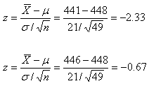
Sampling & CLT
Example :

Slide 42
Sampling & CLT
Example :
.4901
.4901
.2486
.2486
.2415
.2415
441
446
448
X
-2.33
-.67
0
Z

Slide 43
Sampling & CLT

p
Sampling Distribution of Pcap :
Sample Proportion
Sampling Distribution
The central limit theorem holds, and the distribution is approximately normal if np > 5 and nq > 5 (p is the population proportion and q = 1 - p)
The mean of the distribution is p.
The variance of the distribution is pq/n

Slide 44
Sampling & CLT

p
Sampling Distribution of Pcap :

p
or “p hat’ is a sample proportion
Whereas the mean is computed by averaging a set of values, the sample proportion is computed by dividing the frequency with which a given characteristic occurs in a sample by the number of items in the sample

Slide 45
Sampling & CLT
Z formula for sample proportions :

p
−
p
Z
=
p
⋅
q
n
where
:

p
=
sample proportion
n
=
sample size
p
=
population proportion
q
=
1
−
p
n
⋅
p
≥
5
n
⋅
q
≥
5

Slide 46
Sampling & CLT
Example :
If 10% of a population of parts is defective, what is the probability of randomly selecting 80 parts and finding that 12 or more parts are defective?

Slide 47
Sampling & CLT
Example :
Population Parameters
.

15
−
p
p
=
0
P
Z

.
10
p
⋅
q
q
=
1
-
p

1
−
.
10

.
90
n
Sample
.
15
−
.
10

P
Z

(.
10
)
n
=
80
(.
90
)
80
x

12
0
.
05
x
12

P
Z

0
.

0335
p



0
.
15
n
80

P
(
Z

1
.
49
)
Check: np = 80(0.1) = 8 > 5
and nq = 80(0.9) = 72 > 5

.
5
−
P
(
0

Z

1
.
49
)

.
5
−
.
4319
(
p

15
P

.
)


.
0681

Slide 48
Sampling & CLT
Example :
.5000
.5000
.4319
.4319
^
0.10
0.15
p
0
1.49
Z

Slide 49
Associate Analytics Program – Day 9 & 10
Estimating Parameters for Single population
Learning Objectives
Estimate a population mean from a sample mean when s is known.
Estimate a population mean from a sample mean when s is unknown.
Estimate a population proportion using the z statistic.
Use the chi-square distribution to estimate the population variance given the sample variance.
Determine the sample size needed in order to estimate the population mean and population proportion.

Slide 50
Estimating Parameters
Estimating the Population Mean :
A point estimate is a static taken from a sample that is used to estimate a population parameter.
Interval estimate - a range of values within which the analyst can declare, with some confidence, the population lies.
Confidence Interval to Estimate μ when σ is Known
Point Estimate
Interval Estimate

Slide 51
Estimating Parameters
Distribution of Sample Means for 95% Confidence :
.
.025
.025
95%
.4750
.4750
μ
X
Z
-1.96
0
1.96

Slide 52
Estimating Parameters
Estimating the Population Mean :
.
For a 95% confidence interval
α = 0.05
α/2 = 0.025
Value of α/2 or z.025 look at the standard normal distribution table under .5000 - .0250 = .4750
From Table look up 0.4750, and read 1.96 as the z value from the row and column

Slide 53
Estimating Parameters
Estimating the Population Mean :
.
α is used to locate the Z value in constructing the confidence interval
The confidence interval yields a range within which the researcher feel with some confidence the population mean is located
Z score – the number of standard deviations a value (x) is above or below the mean of a set of numbers when the data are normally distributed

Slide 54
Estimating Parameters
95% Confidence Intervals for μ
95%
μ
X
X
X
X
X
X
X

Slide 55
Estimating Parameters
95% Confidence Intervals for μ

Slide 56
Estimating Parameters
Example :
.
A survey was taken of U.S. companies that do business with firms in India. One of the questions on the survey was: Approximately how many years has your company been trading with firms in India?
A random sample of 44 responses to this question yielded a mean of 10.455 years. Suppose the population standard deviation for this question is 7.7 years. Using this information, construct a 90% confidence interval for the mean number of years that a company has been trading in India for the population of U.S. companies trading with firms in India.

Slide 57
Estimating Parameters
Example :
.

Slide 58
Estimating Parameters
Example :
.
A study is conducted in a company that employs 800 engineers. A random sample of 50 engineers reveals that the average sample age is 34.3 years. Historically, the population standard deviation of the age of the company’s engineers is approximately 8 years.
Construct a 98% confidence interval to estimate the average age of all the engineers in this company.

Slide 59
Estimating Parameters
Example :
.

Slide 60
Estimating Parameters
Estimating the Mean of a Normal Population: Sample Size is Small :
.
The distribution of sample means is approximately normal if the population has a normal distribution.
The z formulas can be use to estimate a population mean if the value of the population Standard Deviation is known.

Slide 61
Estimating Parameters
T Distribution :
A family of distributions -- a unique distribution for each value of its parameter, degrees of freedom (d.f.)
t distribution is used instead of the z distribution for doing inferential statistics on the population mean when the population Std Dev is unknown and the population is normally distributed
With the t distribution, you use the Sample Std Dev, s
A family of distributions - a unique distribution for each value of its parameter using degrees of freedom (d.f.)
t formula:

Slide 62
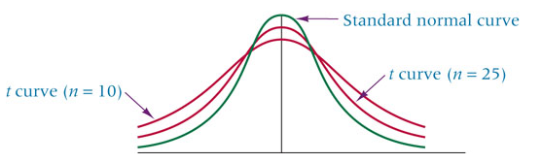
Estimating Parameters
T Distribution Characteristics :
t distribution – symmetric, unimodal, mean = 0, flatter in middle and have more area in their tails than the normal distribution
t distribution approach the normal curve as n becomes larger
t distribution is to be used when the population variance or population Std Dev is unknown, regardless of the size of the sample

Slide 63
Estimating Parameters
Reading the T Distribution :
t table uses the area in the tail of the distribution
Emphasis in the t table is on α, and each tail of the distribution contains α/2 of the area under the curve when confidence intervals are constructed
t values are located at the intersection of the df value and the selected α/2 value

Slide 64
Estimating Parameters
Confidence Intervals for μ of a Normal Population: Unknown σ :

Slide 65
Estimating Parameters
Table of critical values of t :
t0.100
t0.050
t0.025
t0.010
t0.005
df
1
3.078
6.314
12.706
31.821
63.656
2
1.886
2.920
4.303
6.965
9.925
3
1.638
2.353
3.182
4.541
5.841
α
4
1.533
2.132
2.776
3.747
4.604
5
1.476
2.015
2.571
3.365
4.032
23
1.319
1.714
2.069
2.500
2.807
24
1.318
1.711
2.064
2.492
2.797
25
1.316
1.708
2.060
2.485
2.787
0
tα
29
1.311
1.699
2.045
2.462
2.756
30
1.310
1.697
2.042
2.457
2.750
With df = 24 and α = 0.05, t_{α} = 1.711.
40
1.303
1.684
2.021
2.423
2.704
60
1.296
1.671
2.000
2.390
2.660
120
1.289
1.658
1.980
2.358
2.617
∞
1.282
1.645
1.960
2.327
2.576

Slide 66
Estimating Parameters
Confidence Intervals for μ of a Normal Population: Unknown σ

Slide 67
Estimating Parameters
Exercise :
The owner of a large equipment rental company wants to make a rather quick estimate of the average number of days a piece of ditch digging equipment is rented out per person per time. The company has records of all rentals, but the amount of time required to conduct an audit of all accounts would be prohibitive. The owner decides to take a random sample of rental invoices. Fourteen different rentals of ditch diggers are selected randomly from the files, yielding the following data. She uses these data to construct a 99% confidence interval to estimate the average number of days that a ditch digger is rented and assumes that the number of days per rental is normally distributed in the population.
3 1 3 2 5 1 2 1 4 2 1 3 1 1

Slide 68
Estimating Parameters
Excercise :

Slide 69
Estimating Parameters
Confidence interval to estimate the population proportion :
Estimating the population proportion often must be made

Slide 70
Estimating Parameters
Excercise
A clothing company produces men’s jeans. The jeans are made and sold with either a regular cut or a boot cut. In an effort to estimate the proportion of their men’s jeans market in Oklahoma City that prefers boot-cut jeans, the analyst takes a random sample of 423 jeans sales from the company’s two Oklahoma City retail outlets.
Only 72 of the sales were for boot-cut jeans. Construct a 90% confidence interval to estimate the proportion of the population in Oklahoma City who prefer boot-cut jeans.

Slide 71
Estimating Parameters
Excercise

Slide 72
Estimating Parameters
Estimating the Population Variance
Population Parameter σ²
Estimator of σ²
χ² formula for Single Variance

Slide 73
Estimating Parameters
Confidence Interval for σ²

Slide 74
Estimating Parameters
Two Table Values of χ²
df = 7
df
0.950
0.050
1
3.93219E-03
3.84146
2
0.102586
5.99148
3
0.351846
7.81472
4
0.710724
9.48773
.05
5
1.145477
11.07048
6
1.63538
12.5916
7
2.16735
14.0671
.95
8
2.73263
15.5073
9
3.32512
16.9190
10
3.94030
18.3070
20
10.8508
31.4104
.05
21
11.5913
32.6706
22
12.3380
33.9245
23
13.0905
35.1725
24
13.8484
36.4150
0
2
4
6
8
10
12
14
16
18
20
25
14.6114
37.6525
2.16735
14.0671

Slide 75
Estimating Parameters
90% Confidence Interval for σ²

Slide 76
Estimating Parameters
Exercise :
The U.S. Bureau of Labor Statistics publishes data on the hourly compensation costs for production workers in manufacturing for various countries. The latest figures published for Greece show that the average hourly wage for a production worker in manufacturing is $19.58.
Suppose the business council of Greece wants to know how consistent this figure is. They randomly select 25 production workers in manufacturing from across the country and determine that the standard deviation of hourly wages for such workers is $1.12. Use this information to develop a 95% confidence interval to estimate the population variance for the hourly wages of production workers in manufacturing in Greece.
Assume that the hourly wages for production workers across the country in manufacturing are normally distributed.

Slide 77
Estimating Parameters
Exercise :

Slide 78
Estimating Parameters
Determining Sample Size when Estimating :
It may be necessary to estimate the sample size when working on a project
In studies where µ is being estimated, the size of the sample can be determined by using the z formula for sample means to solve for n
Difference between ( x bar ) and µ is the error of estimation

Slide 79
Estimating Parameters
Determining Sample Size when Estimating μ :
z formula
Error of Estimation (tolerable error)
Estimated Sample Size
Estimated σ

Slide 80
Estimating Parameters
Determining Sample Size when Estimating μ : Example :

Slide 81
Estimating Parameters
Example :
Suppose you want to estimate the average age of all Boeing 737-300 airplanes now in active domestic U.S. service.
You want to be 95% confident, and you want your estimate to be within one year of the actual figure. The 737-300 was first placed in service about 24 years ago, but you believe that no active 737-300s in the U.S. domestic fleet are more than 20 years old.
How large of a sample should you take?

Slide 82
Estimating Parameters
Example :

Slide 83
Estimating Parameters
Determining Sample Size when Estimating p
z formula
Error of Estimation (tolerable error)
Estimated Sample Size

Slide 84
Estimating Parameters
Example :
Hewitt Associates conducted a national survey to determine the extent to which employers are promoting health and fitness among their employees.
One of the questions asked was, Does your company offer on-site exercise classes? Suppose it was estimated before the study that no more than 40% of the companies would answer Yes.
How large a sample would Hewitt Associates have to take in estimating the population proportion to ensure a 98% confidence in the results and to be within .03 of the true population proportion?

Slide 85
Estimating Parameters
Example :

